Slide 1


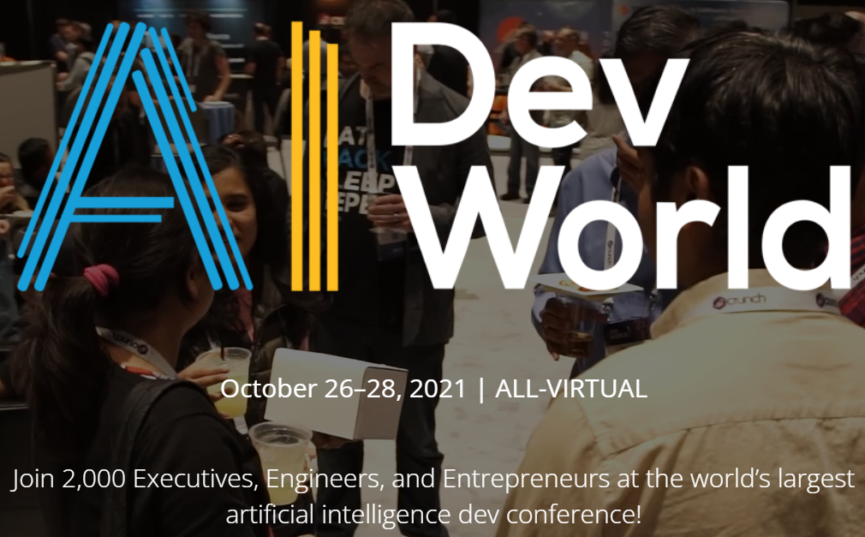
Serverless Deep Neural Network(DNN)with Azure Functions and ML.Net
Praveen Raghuvanshi
@praveenraghuvan
Wednesday, October 27, 2021, 8:30 PM IST
PRO Stage 4
https://aidevworld.com/
Saturday, October 30, 2021, 10:00 AM IST
Track 8
https://azconf.dev/

